Slide 1

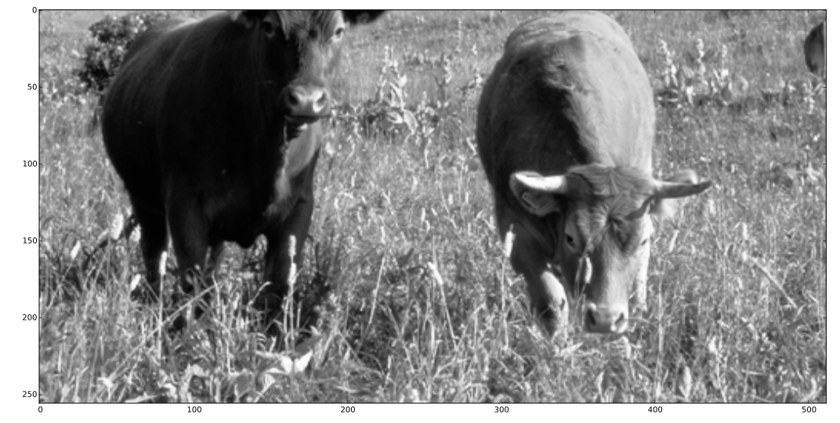
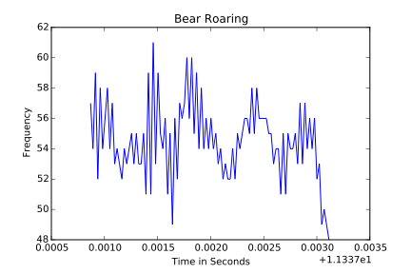
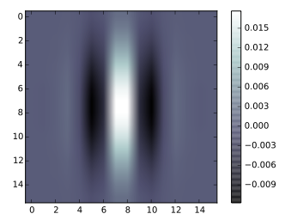
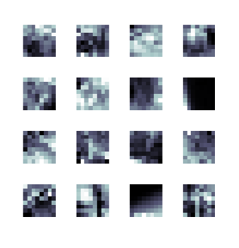
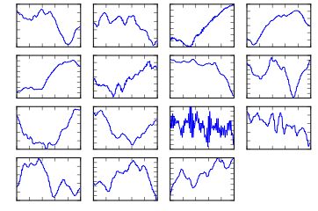
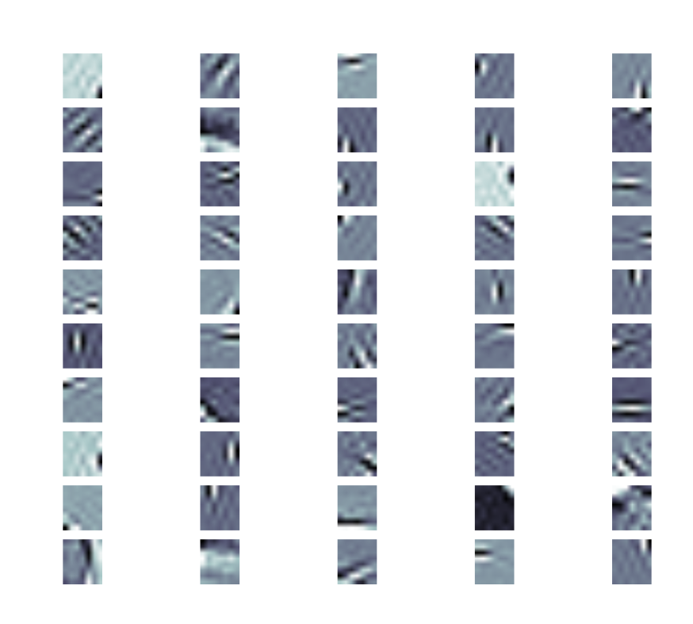
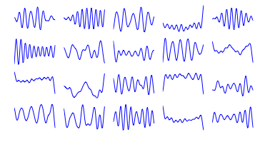
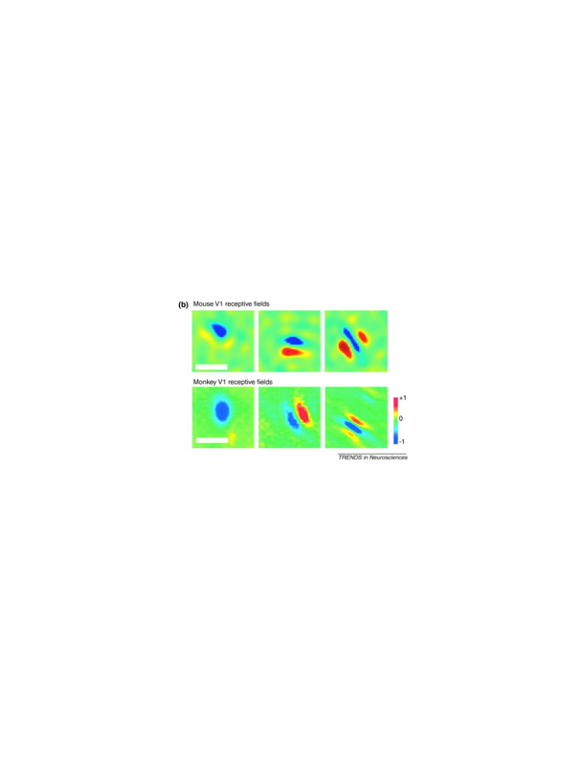
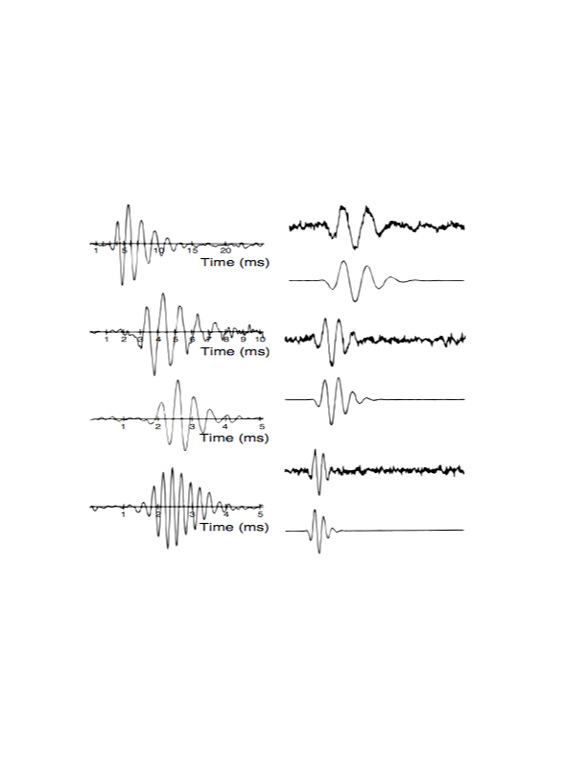
Demonstration of Efficient Visual and Auditory Neural Coding
Suzanne Greenwood^{1,2}, Mary Makarious^{1,2}, Griffin Moe³, Mark V. Albert, PhD³
¹Department of Biology, Loyola University Chicago
²Bioinformatics Interdisciplinary Program, Loyola University Chicago
³Department of Computer Science, Loyola University Chicago
Motivation
The brain exhibits similar computations in different areas. Because of this, it is more important to understand how the brain computes as opposed to what each area of the brain does. This program mimics the computation of the brain to demonstrate the way in which the brain encodes visual and auditory information, and emphasize how similar they are.
Results
Future Objective
The current program requires users to have previous coding experience and to find images/sounds online and insert them into the code to see the output. A phone application would be more user-friendly. The Android application will use the camera and microphone features to capture the user’s environment. Doing this would allow users to visualize how their brains encode the world around them and see how similar visual and auditory information is processed.
Efficient Coding Hypothesis: Theoretical model proposed as a way of understanding neural responses by reducing redundancy in the neural code for natural sensory experiences.
Visual Neural Code
Auditory Neural Code
Abstract
Linear filters resulting from analysis by efficient coding methods are readily visualized as receptive fields. These receptive fields are generated after analysis of random samples of the original image. Using an efficient coding technique, the objective was to demonstrate that the computation that occurring in both the visual and auditory cortices are very similar and that the brain processes these two types of information similarly. Efficient coding is not like coding on a computer. Instead of minimizing the number of 1s and 0s, only the 1s are being minimized. Similarly, the goal is not to minimize the number of neurons, just focusing on code with minimal neural spikes.
Original
Conclusion
The program as it is functions in analyzing visual and auditory information using the same computation. The algorithm used doesn’t produce the different results, but rather the different data that’s fed in. It is very useful for demonstrating the relationship between the computation in the visual and auditory cortices, but can be improved by incorporating it into an Android application to make it more accessible to users, allowing them to compare for themselves.
Above is an example of an original image to be encoded.
Above is an example of an original sound to be encoded.
The visual filter to the left illustrates the vertical nature of the neuron and where the strongest neural response would be.
Samples
These are random samples taken from the original photo.
These are random samples taken from the original sound clip. These 15 graphs are random 100 millisecond clips.
References
Albert MV, Field DJ (2009) "Neural Representation and Coding."Encyclopedia of Perception, Ed. E.B. Goldstein et al., SAGE Press. Huberman, Andrew D., and Cristopher M. Niell. "What Can Mice Tell Us about How Vision Works?" Trends in Neurosciences 34.9 (2011): 464-73. Web. Lewicki, Michael S. "Efficient Coding of Natural Sounds." Nature Neuroscience Nat. Neurosci. 5.4 (2002): 356-63. Web. Olshausen BA, and Field DJ. (1996). "Emergence of Simple-Cell Receptive Field Properties by Learning a Sparse Code for Natural Images." Nature, 381: 607-609. Olshausen BA, and Field DJ. (1996). "Natural image statistics and efficient coding." Network: Computation in Neural Systems, vol. 7, 333-339
Methods
Natural images and sounds were collected. These are samples found in nature. (Pictures of animals or the sound of rain) The image or sound was broken down to several smaller patches. An efficient coding method, known as ICA, was used. Breaking it into individual components for analysis would produce similar receptive fields produced in both the visual and auditory cortices. Filters were generated. (Gabor-like filters for the images and gammatone filters for the sounds) The filters produced represent the areas of high neural excitation and, therefore, theoretically represents how the neurons communicate and the brain processes the information.
Produced Filters
The figures above are the resulting Gabor filters from ICA. These filters resemble the response properties of a V1 simple cell.
The figures above are the resulting gammatone filters from ICA. These filters resemble the response properties of neurons that make up an auditory nerve.
Actual Filters
Acknowledgements
This work was supported by HHMI medical group via the “Sustaining Excellence” grant #52008101 and the Loyola University Chicago FYRE program.
The filter above illustrates the actual neural receptive field. (Huberman, 2011)
The figure above is the actual neural response.
(Lewicki, 2002)
Notes:
Motivation should be more general and connect with the why were doing something like this
How this will relate to griffins app → picture of a cell phone
Put in early: two areas of the brain performing same computation
Separate objectives : ours → writing the code in order to create the efficient codes from audio and visual samples griffin’s : create the app
Don’t say ICA anywhere on the left : important thing is that both areas of the brain are performing the same efficient computation
Methods : finding natural images and sounds then using an efficient coding method to produce visual and auditory receptive fields similar to what you see in the brain ICA is a parenthetical (definitely in methods; is the tool we used)
Removing redundancy
Results and conclustions
Pictures of natural images and whole clips of the sound wave
Then clips of the images and sounds
Then resulting filters
Variation in sounds and images so you see the difference between images and sounds
Pick things that will get an interesting variation
Noise images willl mess this up
Be creative (clouds, cartoons, text to make it clear that its not the algorithm that makes the cells it’s the data that makes the cells)
Same with sounds
(bird calls vs speech; gunshots and crunching leaves? …)
Need an introduction; not so much a discussion but conclusion
What is a receptive field section
More natural scenes and sounds produce more physiological filters
References
Dr alberts phd work
Acknowledgements
Definitely HHMI and FYRE grant number (kelsey)
Names: us, griffin, Albert
Albert & Griffin = computer science department
We are biology
Neuroscientists have tried to understand the brain by relating neural stimuli to what caused them. Complicated math descriptions with no underlying concept of why those neural responses occur. Here we are demonstrating that these 2 types of neural responses can be explained
Efficient coding hypothesis
natural images/sounds
clips/patches
resulting ica images (Gabor) auditory filters (Gammatone)
Real pictures

